Slide 1

Healthcare, security and technology

Slide 2
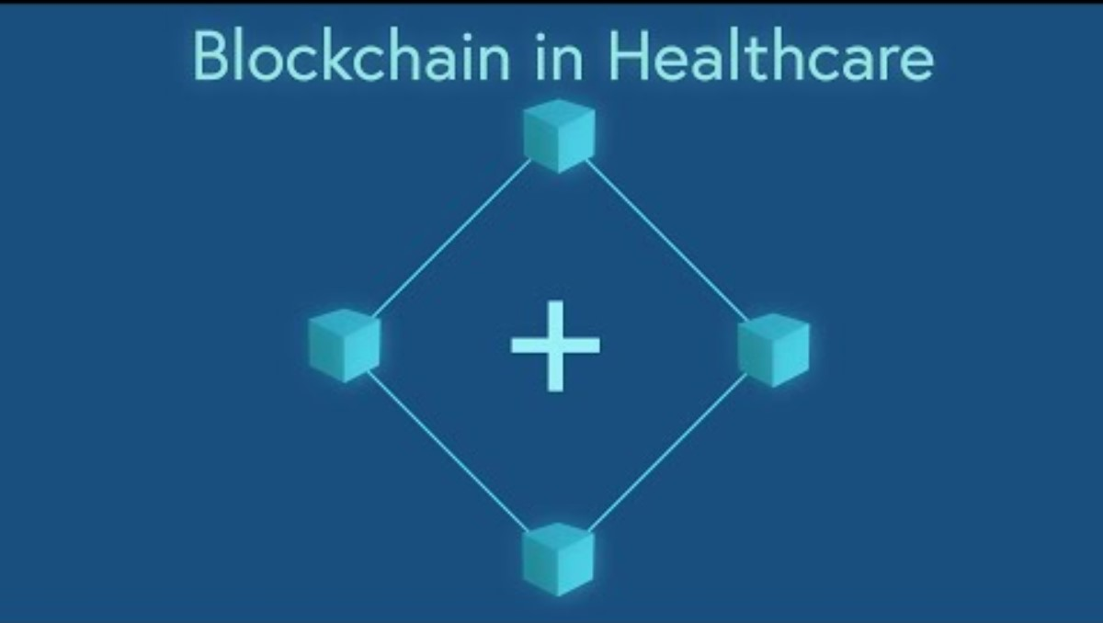


Slide 3


Zero Knowledge Proofs in Blockchain

Slide 4

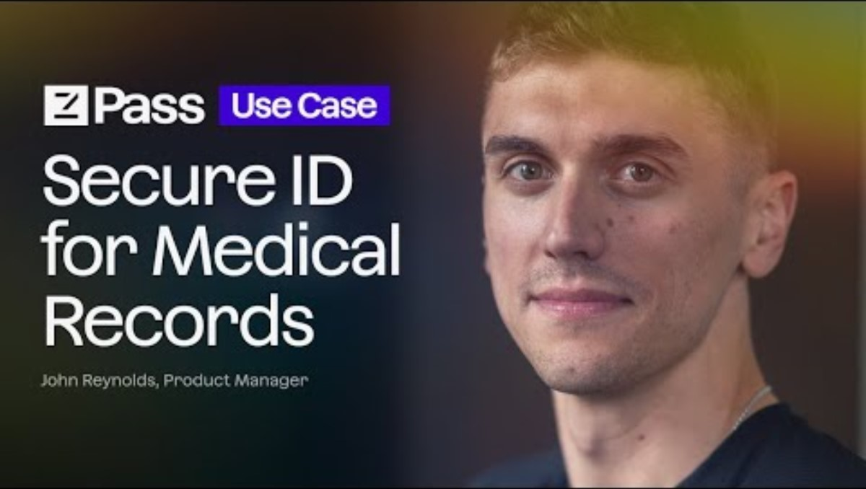
Example of zKP with HER
What other applications can you imagine this would be valuable for?

Slide 5
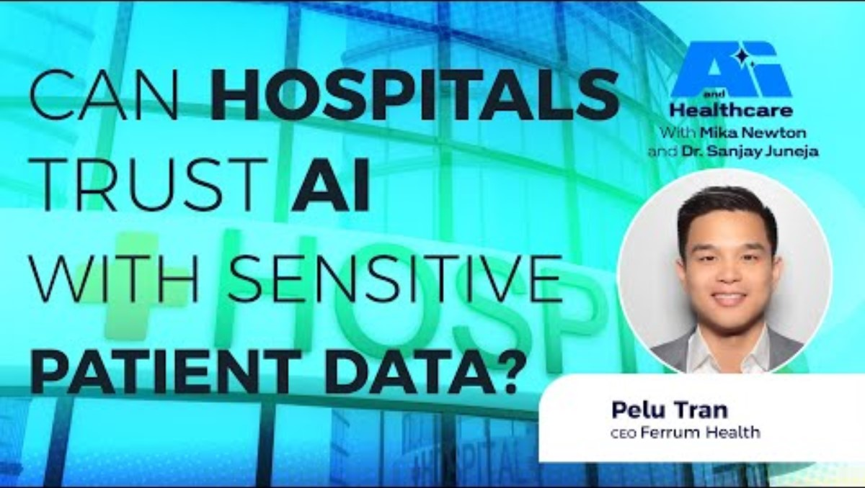
Artificial Intelligence and Security in Healthcare
Open Source
Llama 3 – Meta – language understanding/multilingual tasks
DeepSeek – Chinese Hedge fund High-Flyer – math/reasoning

Slide 6

EHR Interoperability

